Slide 1
NYC Subway Ridership Analysis
Rui Yuan

Slide 2
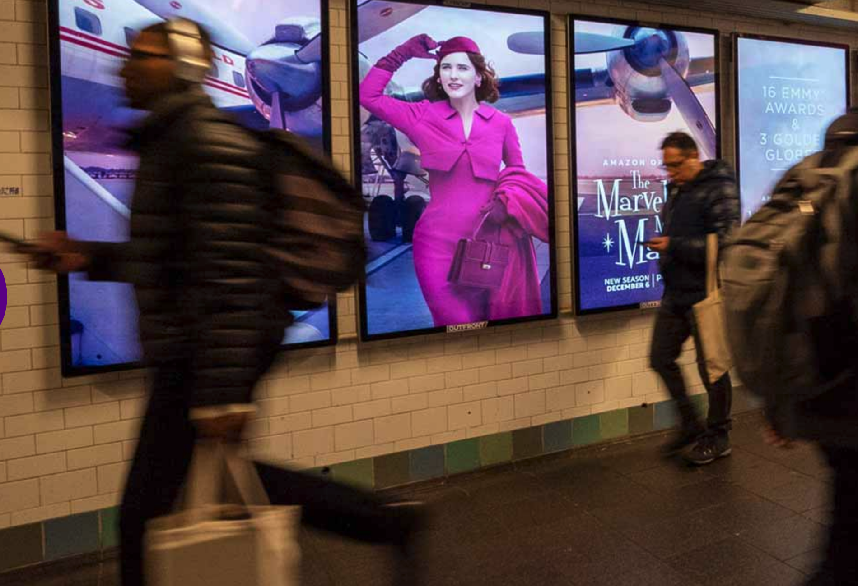
Client
&
Objective
Client: OUTFROUNT Media, the company that handles transit advertising opportunities of NYC subway.
Objective: Find the optimal price positioning of advertising in NYC subway according to ridership analysis.
Digital poster (pic from outfrontmedia.com)

Slide 3
Methodology
Data Used:
MTA turnstile data focused on 2022 Q1 (Jan, Feb, Mar).
2019 Q1 and 2022 Q1 data for comparison.
Method:
Two focuses: Location & Time.
Rank traffic volume by stations and time periods.

Slide 4
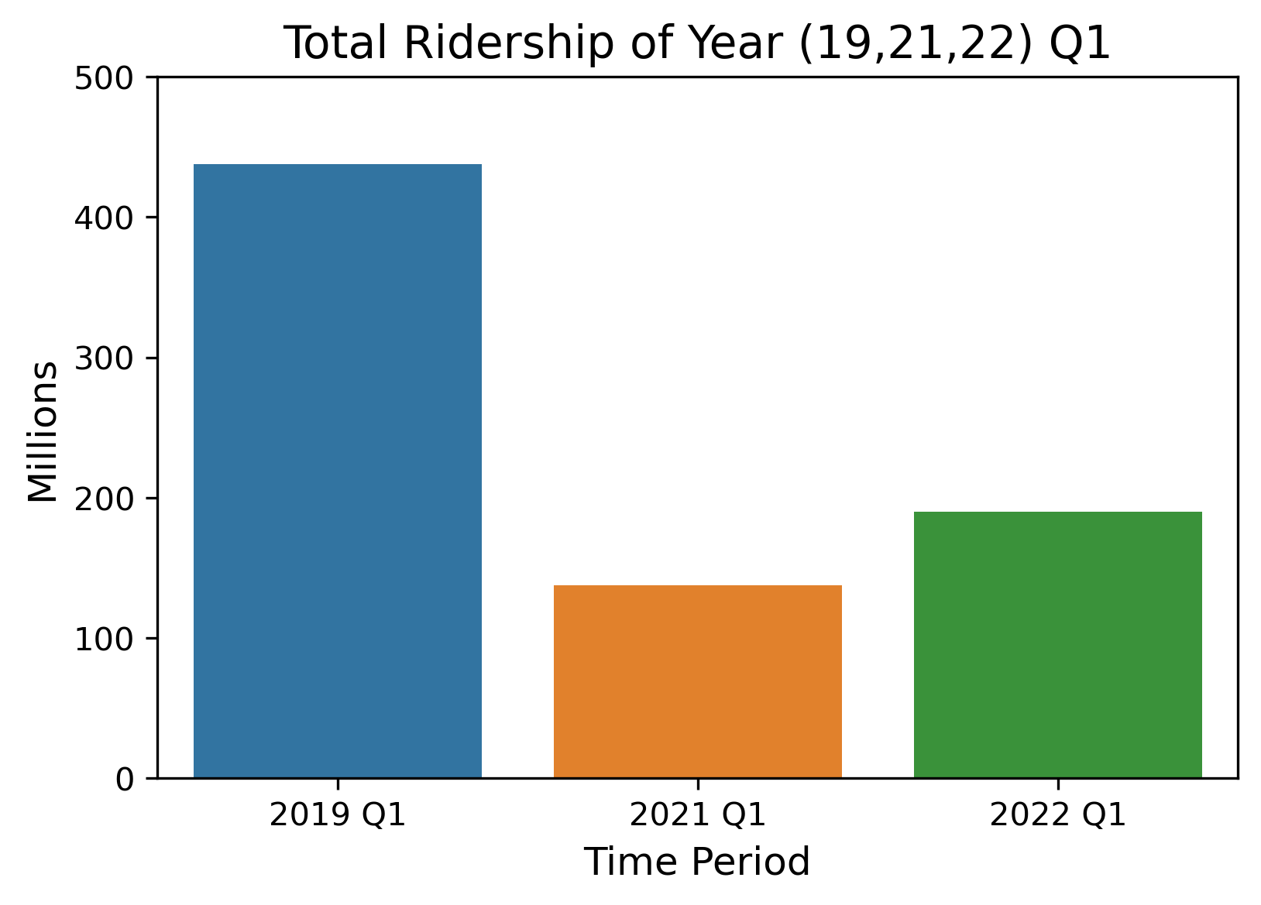
NYC Subway Traffic Volume Overview
- 56.6%
Pre-pandemic
+ 37.8%
One year through pandemic
Current
Notes:
Current ridership is 56.6% less than pre-pandemic level 2022 Q1 ridership has seen a 37.8% increase from 2021 Q1

Slide 5
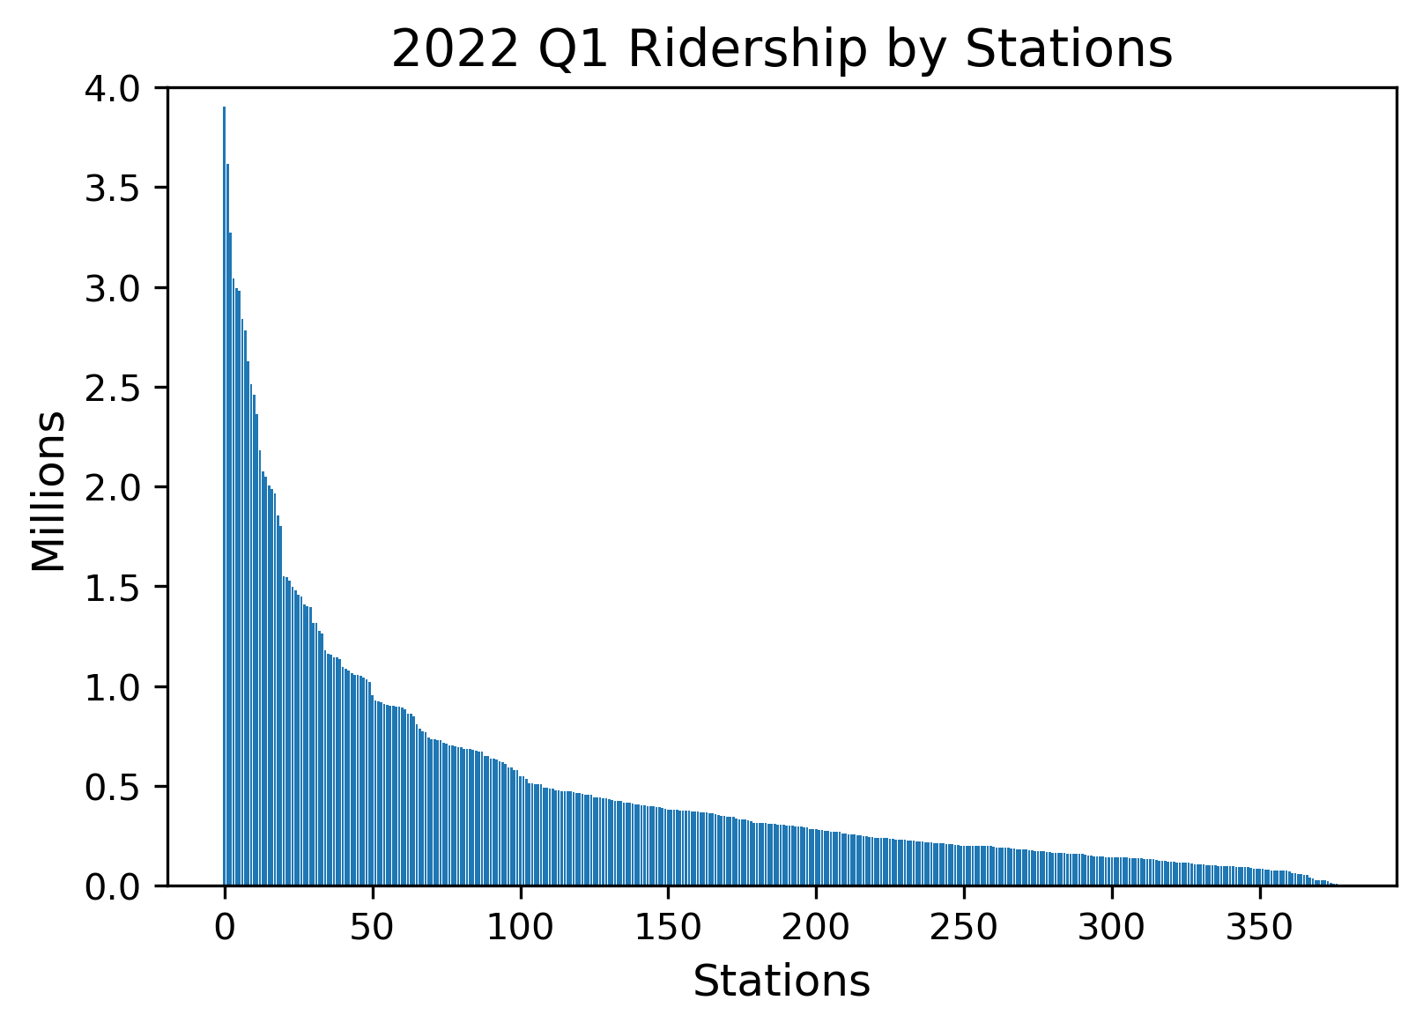

Ridership Distribution by Stations
20 (5%) stations
45 (10%) stations
93 (25%)
stations
220 (60%) stations
Lowest: 2 Entries

Slide 6
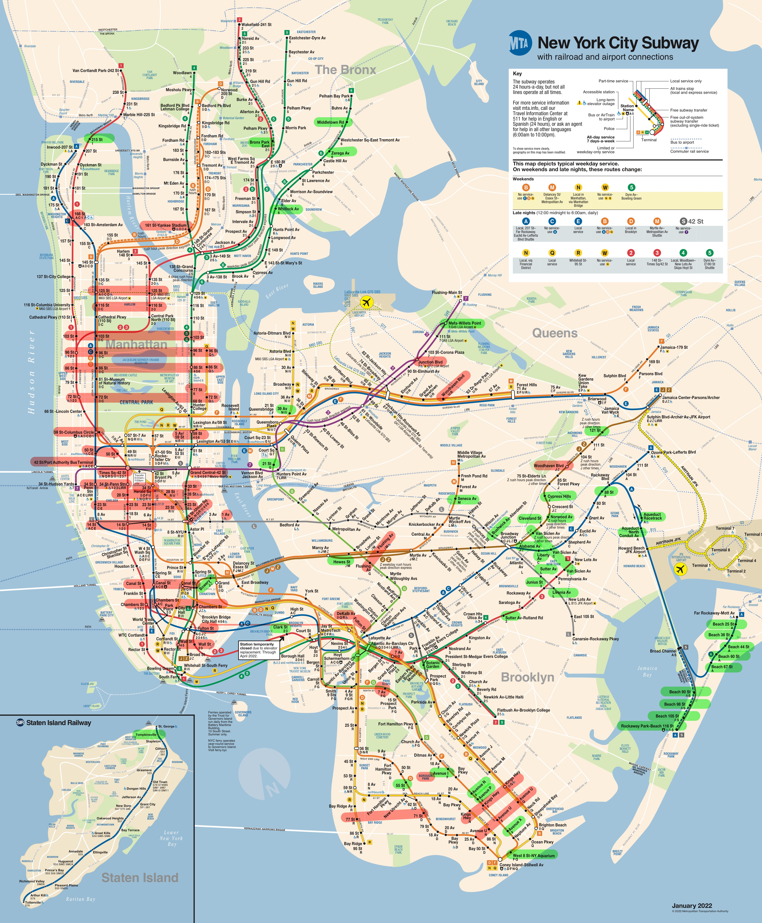
Most & Least Used Stations Location Most used stations marked in red
least used stations marked in green
Traffic centered in Manhattan

Slide 7
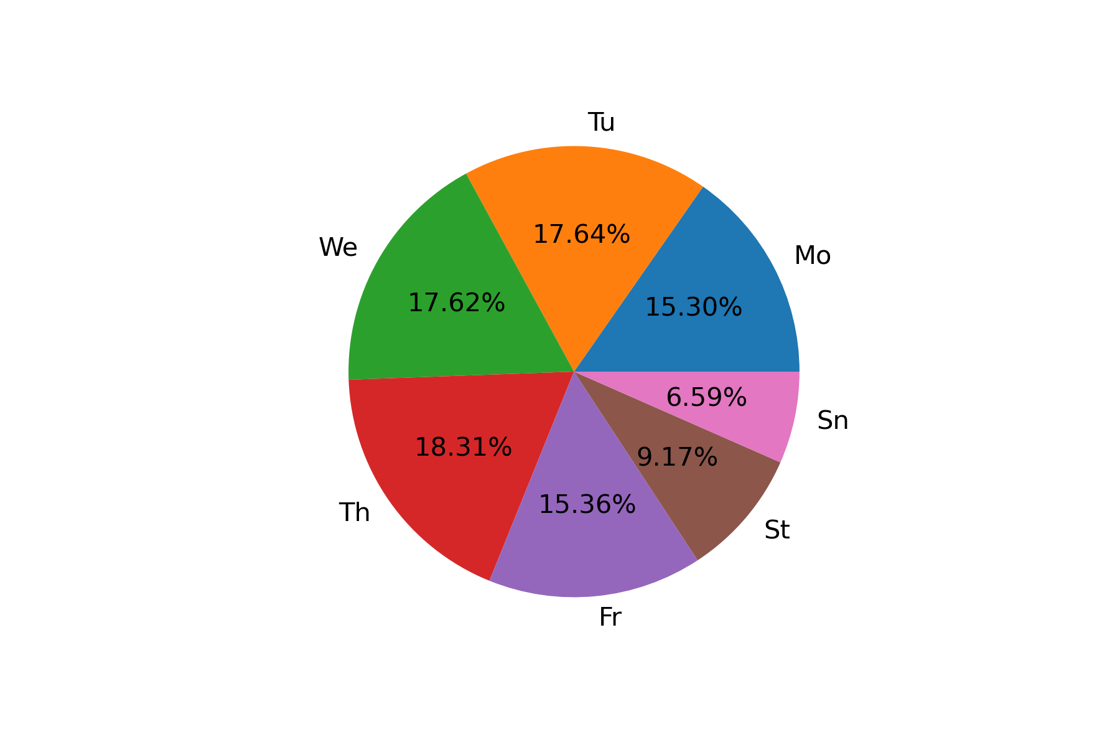
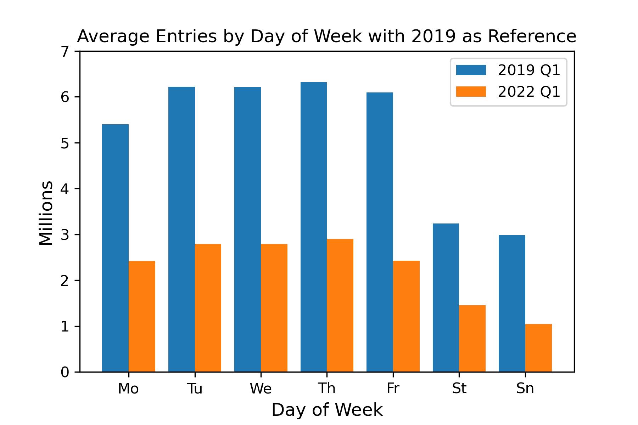
Ridership Distribution by Day of Week
2022 Q1 ridership share by day of week
15.76%
Pricing : Mo = Tu = We = Th = Fr = (St + Sn)
Notes:
Weekdays see more traffic than weekends.
In 2022 Q1, Thursdays have bigger share and Fridays have less share comparing to pre-pandemic level.
The more unbalanced shares of Weekdays in 2022 may stem from hybrid work model.

Slide 8
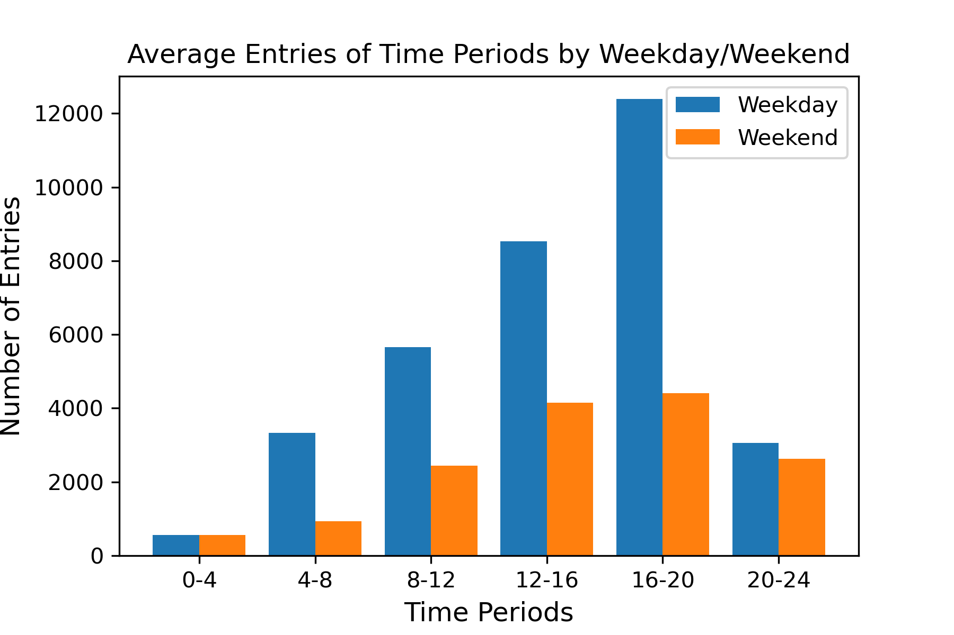
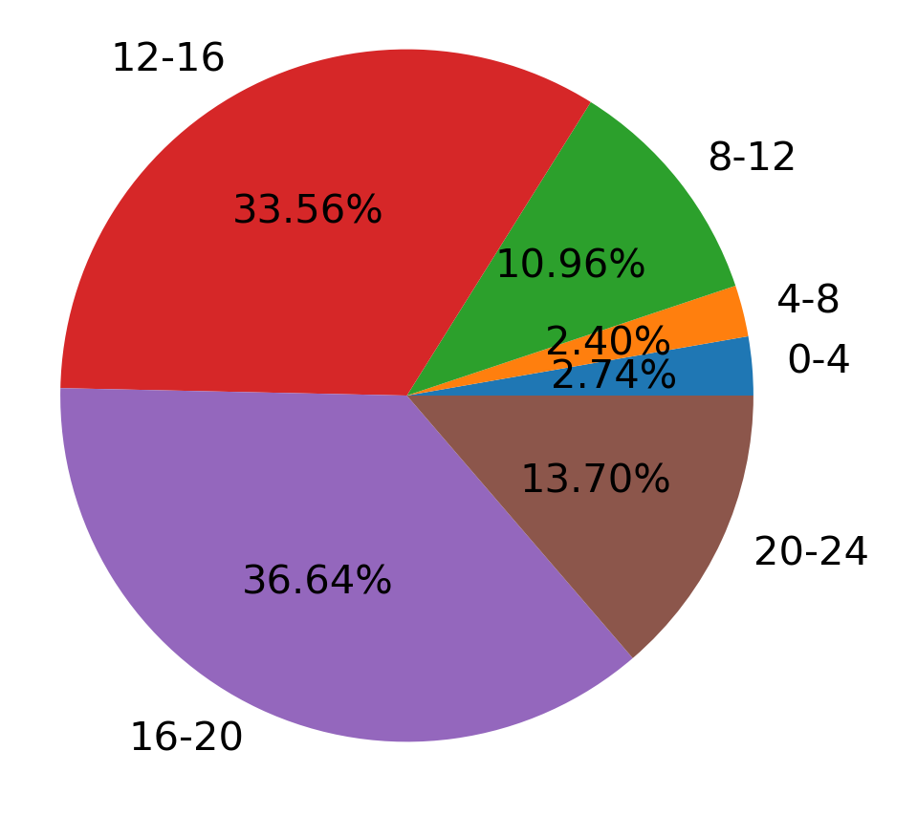
Ridership Distribution by Time Period of Day (Station 59 ST in 3/21-3/28 one week data)
2022 Q1
Ridership Share for Entire Week
12 to 20 = 70% of total daily ridership

Slide 9
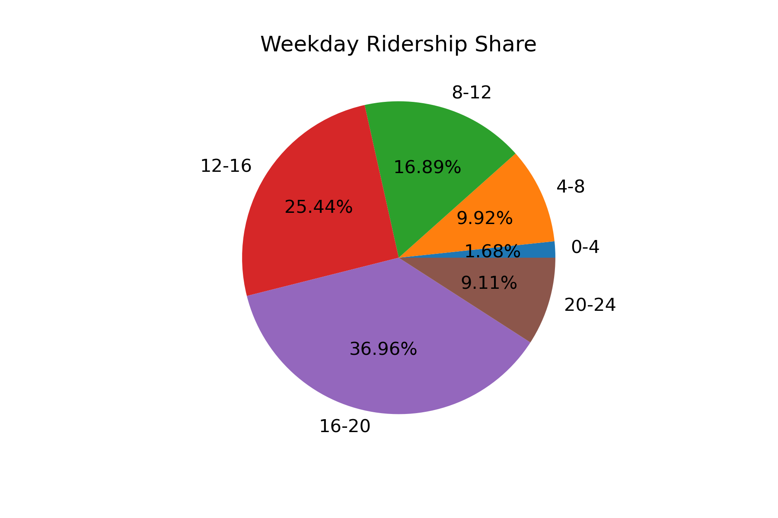
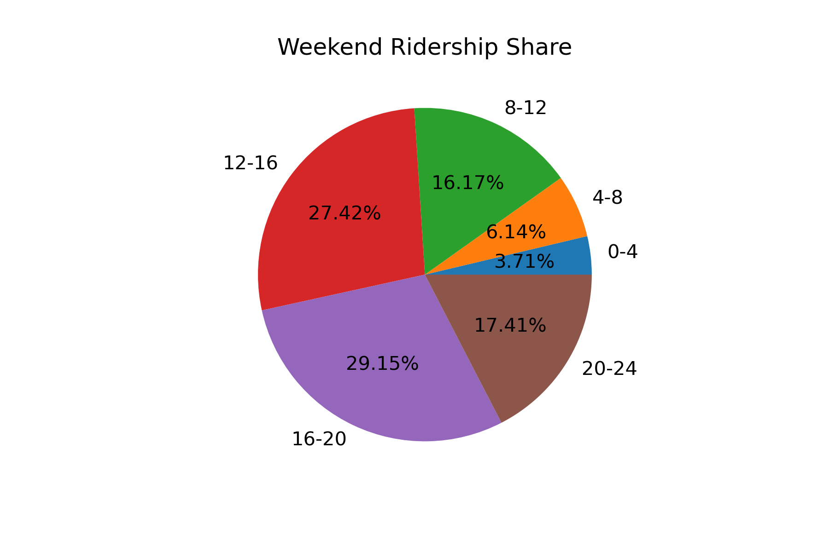
Ridership Distribution by Time Period of Day (Station 59 ST in 3/21-3/28 one week data)
Notes:
Time period 16 - 20 has more share in weekdays than in weekends.
20 - 24 period takes more share in weekends than in weekdays.

Slide 10
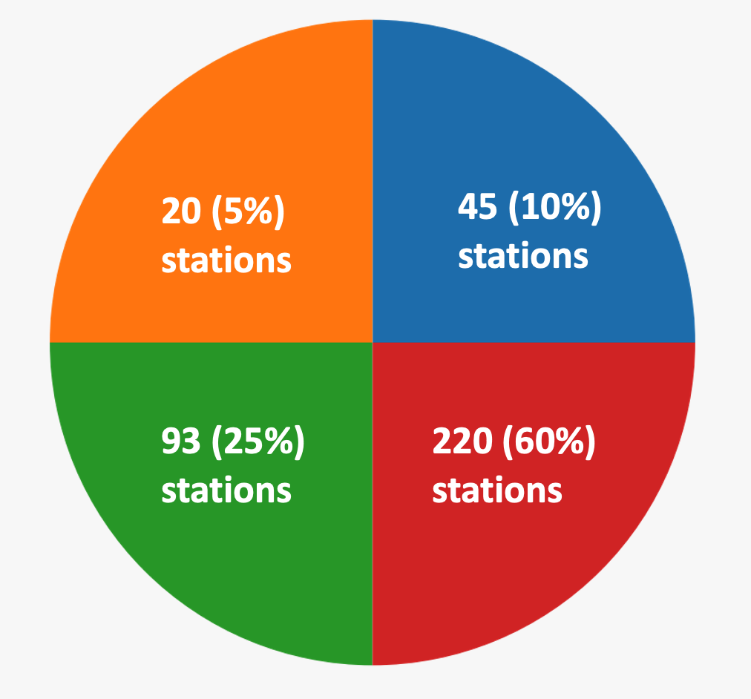
Advertising Pricing Strategy Wrap-up
Pricing Strategy:
A flexible tiered pricing list based on ridership share of stations, and more detailed pricing positioning based on ridership share per day of week and per time period of day.
Location Time
Station
Day of Week
Mo = Tu = We = Th = Fr = (St + Sn)
Time Period of Day
12 to 20 = 70%

